Slide 1
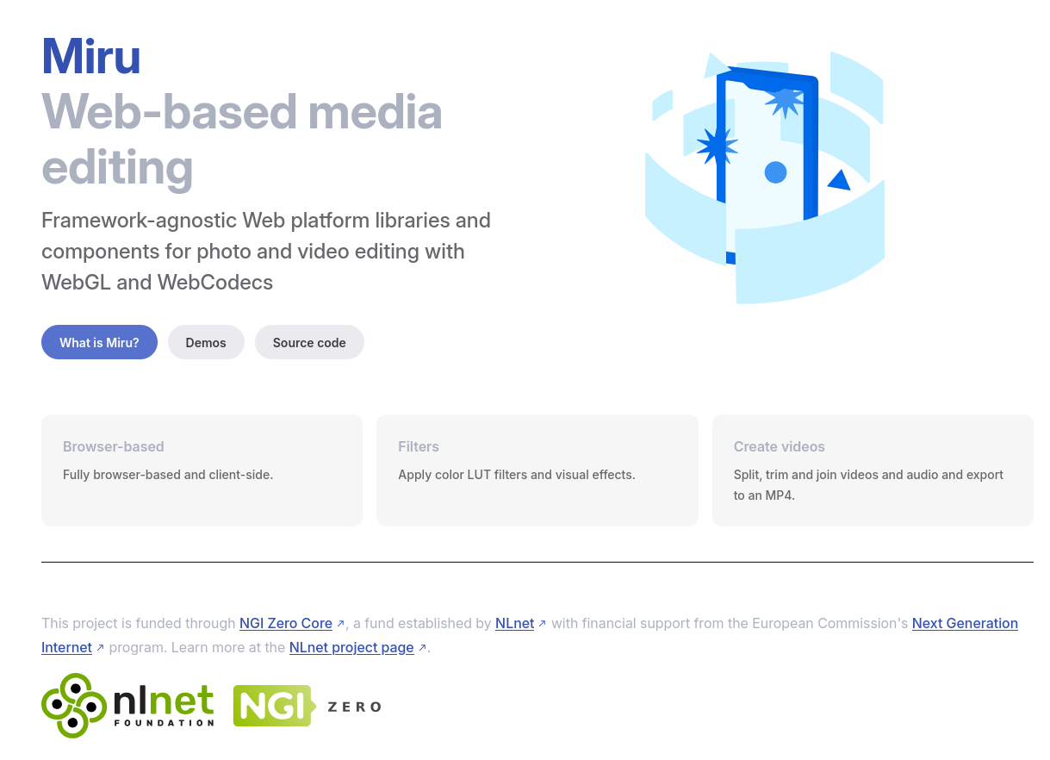
Miru: Building a collaborative video editor with offline support
Notes:
Hi, I’m Taye Adeyemi and I started the project Miru to create a set of media editing tools for web apps. The work is funded through NGI Zero established by NLnet.

Slide 2
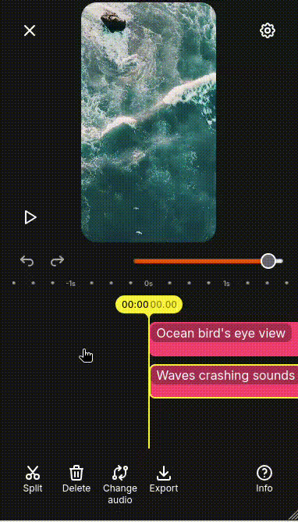
https://miru.media/video-editor
Pretty simple and easy to use
Can add multiple video and audio clips, rearrange, trim, etc, export
Compsiting is done with the videocontext library (for now) to a WebGL canvas
Uses WebCodecs for exporting
Notes:
At the moment I’m building out the video editing tools to add more features for video editors working together on short form content

Slide 3
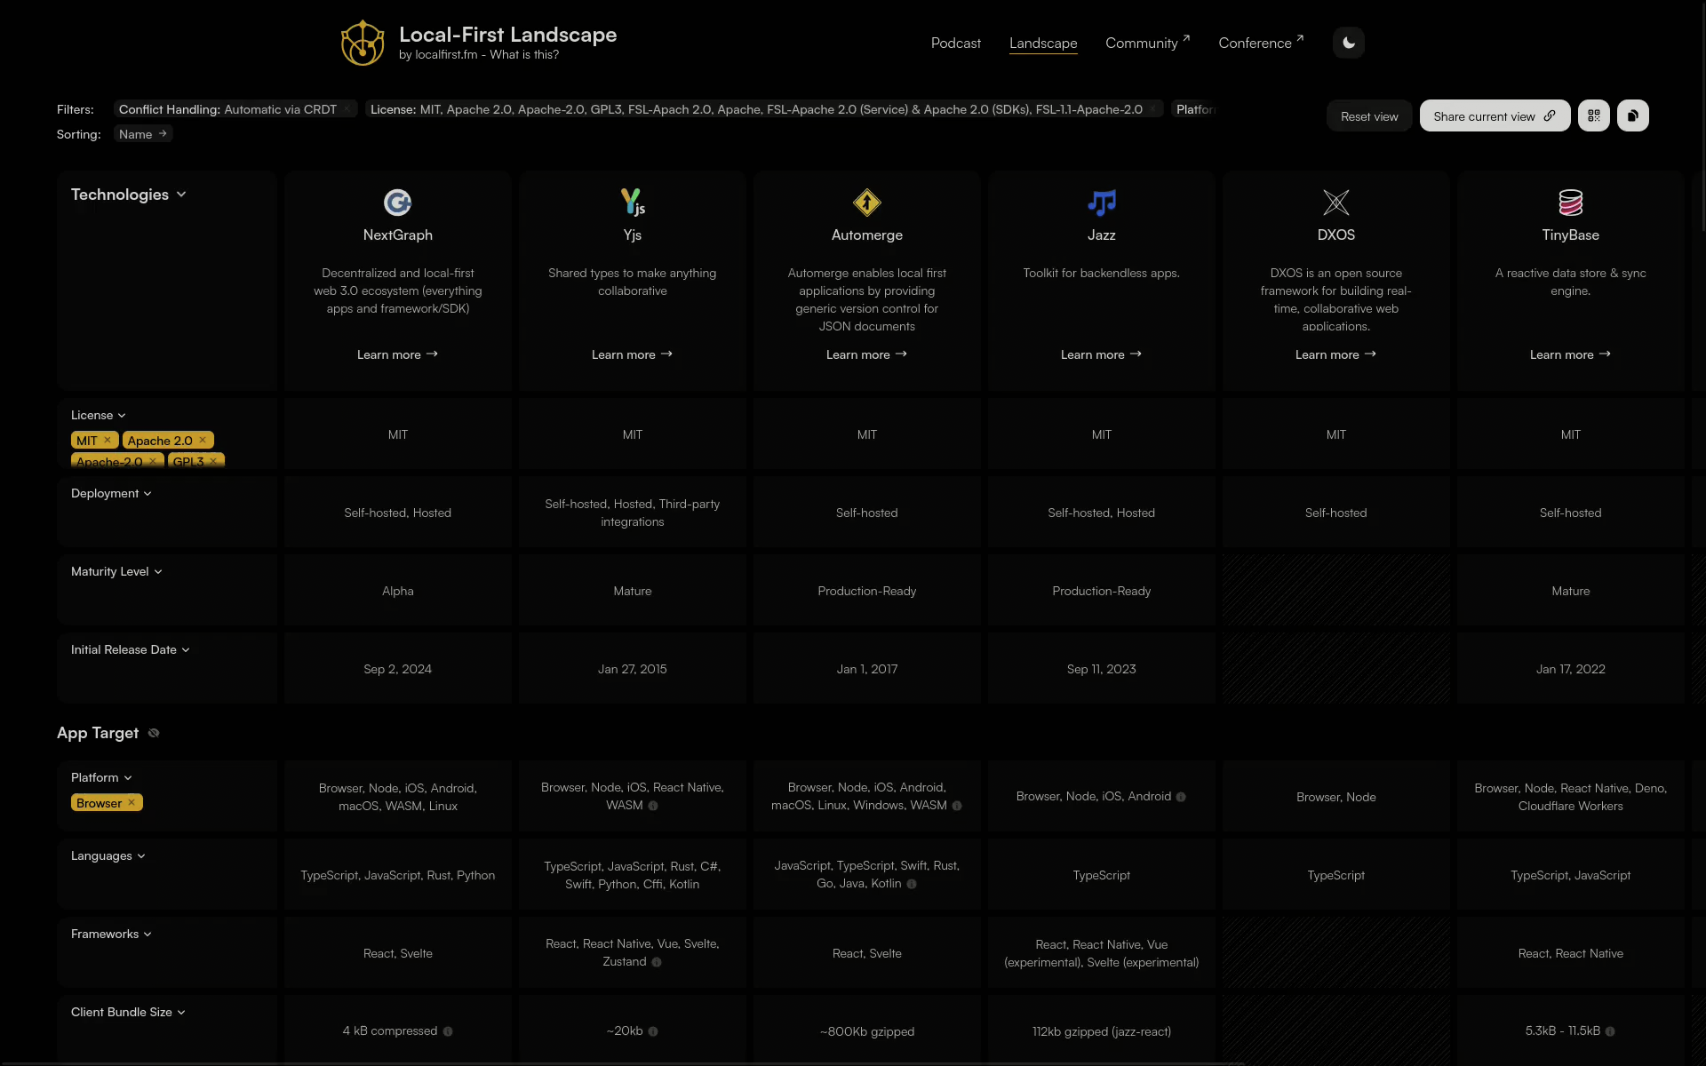
https://www.localfirst.fm/landscape
Where can you find out about what CRDT libraries are out there?
Notes:
At the start of this adventure, I went looking for what CRDT libraries are out there and I came across this very useful website localfirst.fm. It has a page where you can see an overview of a bunch of different libraries in the local-first ecosystem

Slide 4
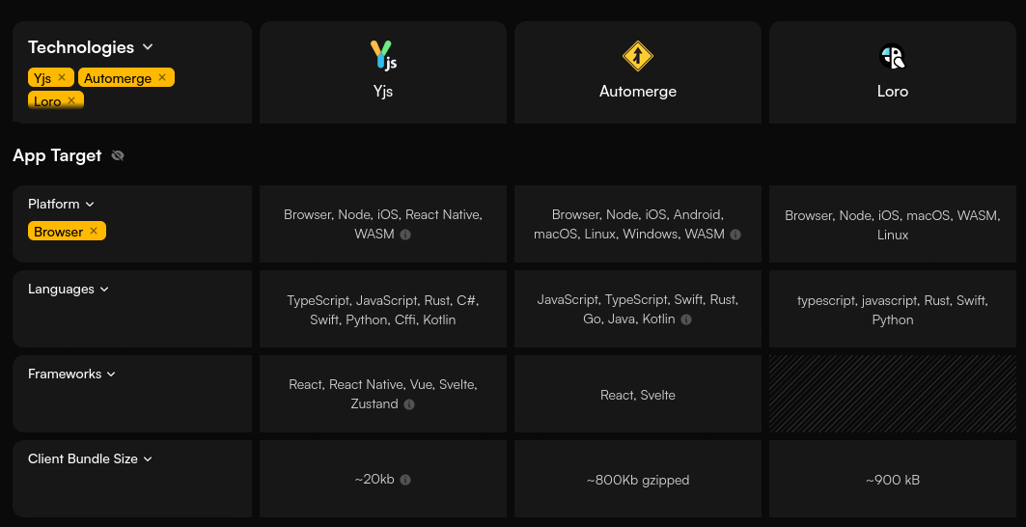
Yjs: most popular, great ecosystem, small bundle size
Automerge: comparable features to yjs, ~1MB wasm build, smaller ecosystem
Loro: newer, has support for move operations, ~1MB wasm build

Slide 5
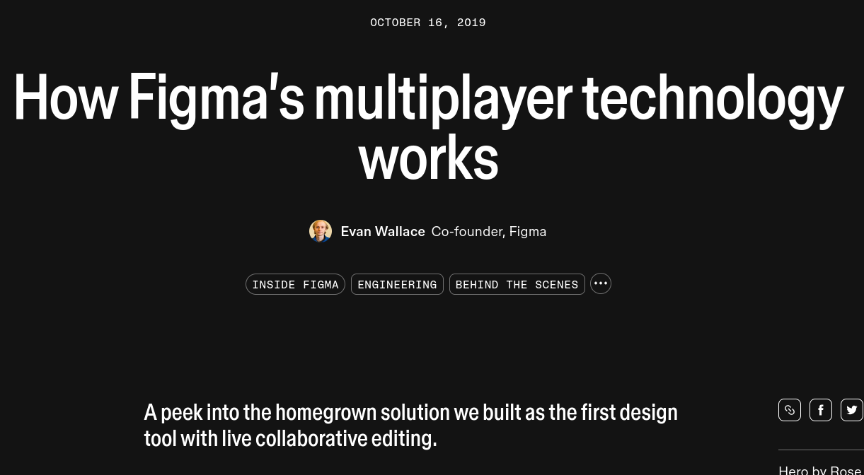
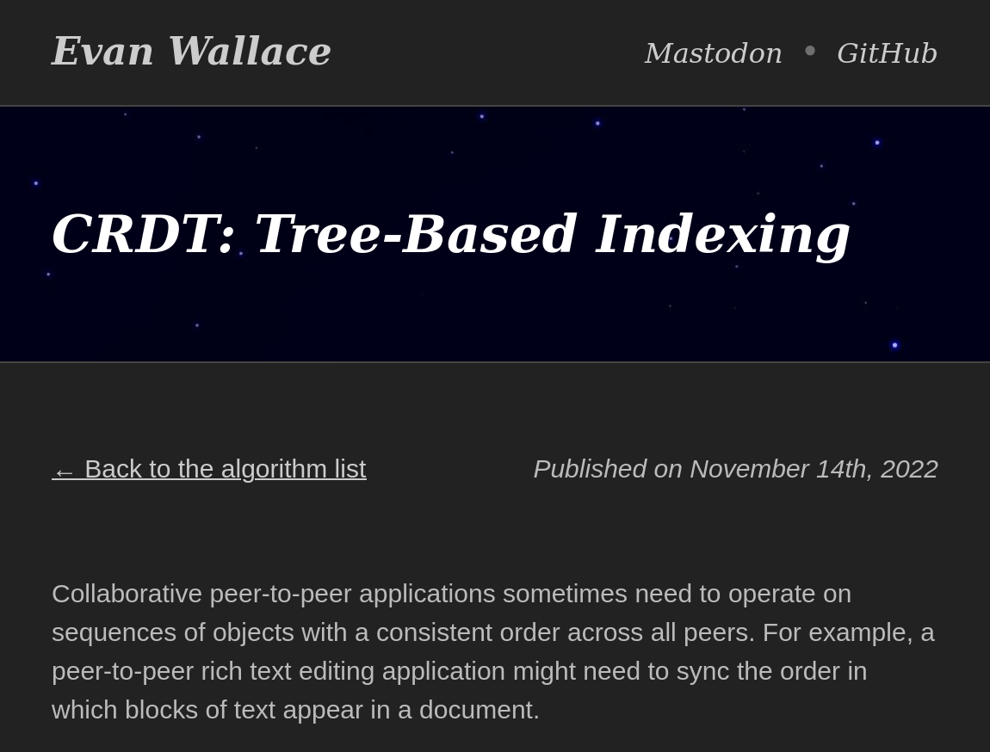
https://www.figma.com/blog/how-figmas-multiplayer-technology-works/
https://www.madebyevan.com/algos/crdt-tree-based-indexing/
Notes:
If you’re looking at making any collaborative design/creativity software, you’ll almost certainly end up at some of Evan Wallace’s articles. They’re very good places to start

Slide 6
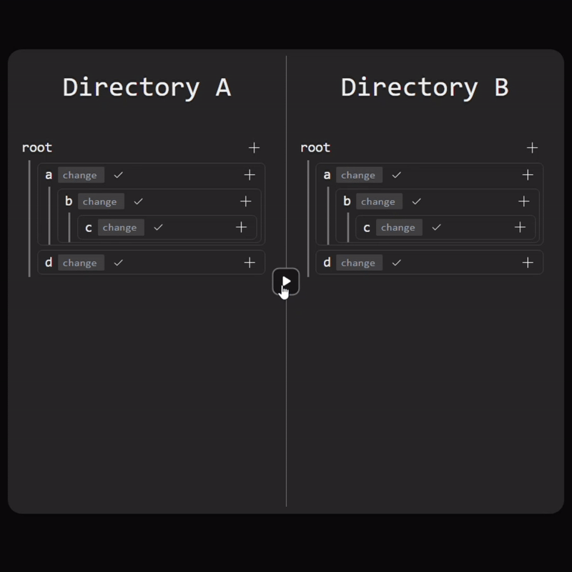
https://github.com/ProjectWR/yjs-orderedtree
Notes:
So in the Yjs readme, there’s mentioned a library called yjs-orderedtree that implements the mutable ordered tree that Evan lays out

Slide 7
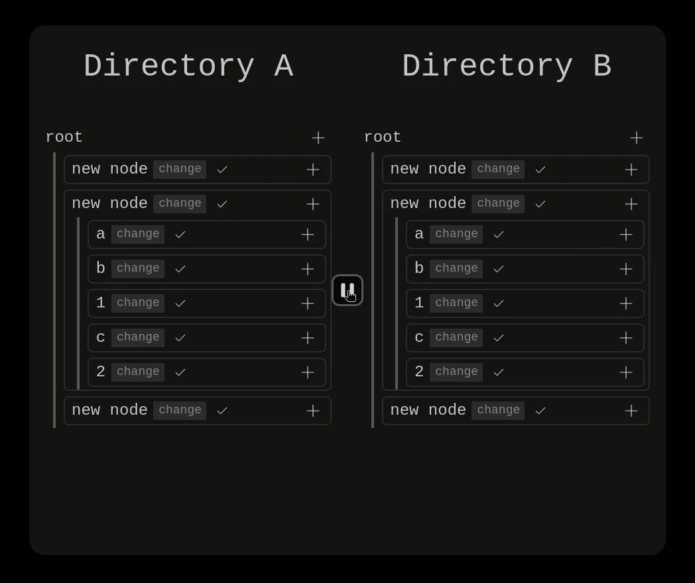
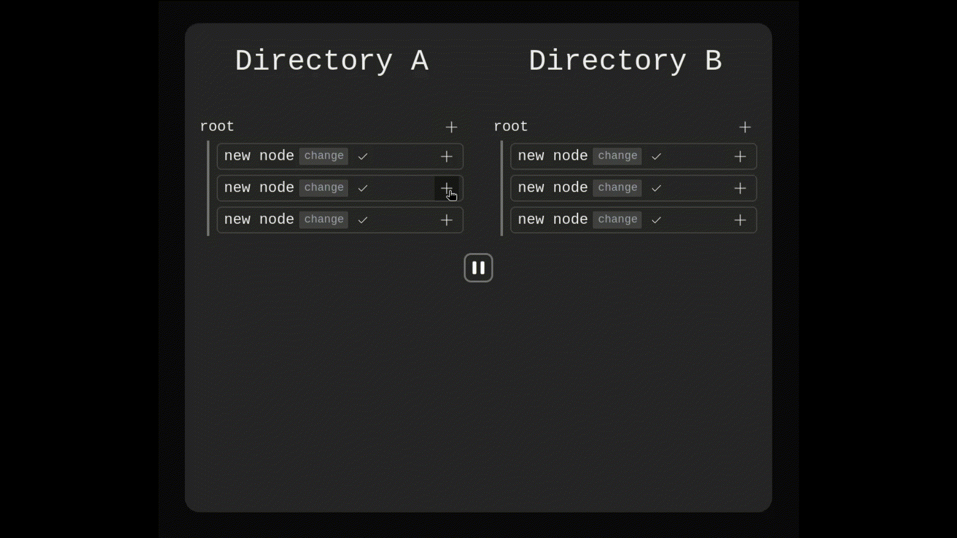
Interleaving issues
Notes:
This is what interleaving looks like in a directory. These would be sorted by name, creation time, etc. so it’s not an issue here, but in a timeline, you’d have clips appearing in the wrong order.
You won’t ever really see this if your application has the requirement of always being online like Figma, but that’s not local-first.
But anyway, we can solve this by borrowing from text CRDTs [citation needed].
The real problem is making sure that updates are merged in ways that are intuitive and expected by users.

Slide 8

What is expected when one user splits a clip, and the other changes the duration of the original clip?
What if the clip’s media asset is swapped out?
Undoing the split or deleting the orignal while another user edits the two new clips?
🤷
Notes:
Let’s take splitting clips for example.
I initially implemented this by shrinking the clip and adding a second clip after it, but that wasn’t good. Now I delete the old clip and replace it with two new ones.
There isn’t always one expected result. Each editor doesn’t know the intentions of every other editor.

Slide 9
And what about
🤷
🤷
Transitions
Subtitles
Keyframe animations
Linked (not grouped) clips that are moved together
🤷
🤷

Slide 10
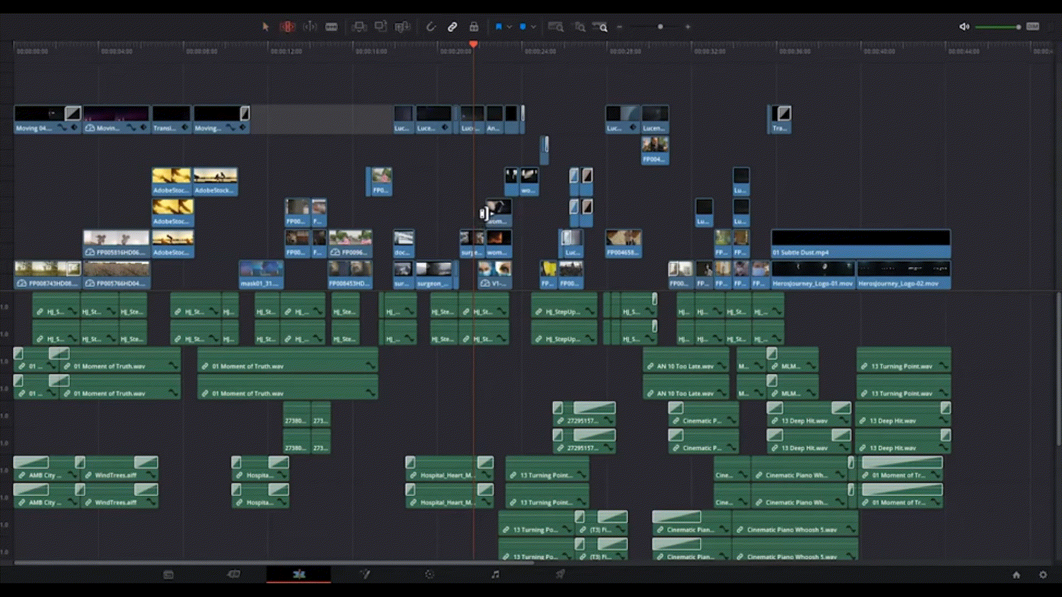
In other more advanced editors with ripple editing, changing one clip can affect other clips across multiple tracks
🤷
🤷
🤷
Notes:
For my sanity, I’ve avoided thinking about all the ways this might ruin everything
Talk to people to find out how they work and what they expect from merges
Try out different aproaches
I’m optimistic
It’s fun. Come talk to me about it later if you have any ideas

Slide 11


Thank you!
https://codeberg.org/miru-media/miru
https://github.com/miru-media/miru

